Slide 1
Parted

Slide 2
Parted is a famous command line tool that allows you to easily manage hard disk partitions. It can help you add, delete, shrink and extend disk partitions along with the file systems located on them.
Parted is preinstalled

Slide 3
Check Parted Version
Command <parted>
Output /dev/sda
Quit from parted
<quit>

Slide 4
List Linux Disk Partitions
To see the disk partitions run <print>
When running print, it will also display the hard disk information and model.
List or Switch to Different Disk
<select /dev/sdb>

Slide 5
Create Primary or Logical Partition in Linux
<mkpart>
Resize Linux Disk Partition
<resize>
Delete Linux Partition
<rm disknumber >

Slide 6
Linux File System
A Linux file system is a structured collection of files on a disk drive or a partition.
A partition is a segment of memory and contains some specific data

Slide 7
Reasons for maintaining the file system
Primarily the computer saves data to the RAM storage; it may lose the data if it gets turned off. However, there is non-volatile RAM (Flash RAM and SSD) that is available to maintain the data after the power interruption.
Data storage is preferred on hard drives as compared to standard RAM as RAM costs more than disk space.

Slide 8
file system contains the following sections:
The root directory (/)
A specific data storage format (EXT3, EXT4, BTRFS, XFS and so on)
A partition or logical volume having a particular file system.

Slide 9
Linux File System Structure
Linux file system has a hierarchal file structure as it contains a root directory and its subdirectories.
All other directories can be accessed from the root directory.

Slide 10
/
This is the root directory which should contain only the directories needed at the top level of the file structure
/dev
These are device drivers
Essential device files, e.g., /dev/null
These include terminal devices, usb, or any device attached to the system.

Slide 11
/bin
Essential command binaries that need to be available in single-user mode; for all users, e.g., cat, ls, cp.
Contains binary executables
Common linux commands you need to use in single-user modes are located under this directory.

Slide 12
/etc
Contains configuration files required by all programs.
This also contains startup and shutdown shell scripts used to start/stop individual programs.
/lib
Contains shared library files and sometimes other kernel-related files

Slide 13
/boot
Contains files for booting the system
/home
Contains the home directory for users and other accounts
/mnt
Used to mount other temporary file systems, such as cdrom and floppy for the CD-ROM drive and floppy diskette drive, respectively

Slide 14
/proc
Contains all processes marked as a file by process number or other information that is dynamic to the system
/tmp
Holds temporary files used between system boots
/usr
can be used by many users. Includes administrative commands, shared files, library files, and others

Slide 15
/var
Typically contains variable-length files such as log and print files and any other type of file that may contain a variable amount of data
/sbin
Contains binary (executable) files, usually for system administration. For example, fdisk and ifconfig utilities
/kernel
Contains kernel files

Slide 16
Linux File System Features
Specifying paths
Partition, Directories, and Drives
Case Sensitivity
File Extensions
Hidden files

Slide 17
Specifying paths: Linux does not use the backslash (\) to separate the components; it uses forward slash (/) as an alternative. For example, as in Windows, the data may be stored in C:\ My Documents\ Work, whereas, in Linux, it would be stored in /home/ My Document/ Work

Slide 18
Partition, Directories, and Drives: Linux does not use drive letters to organize the drive as Windows does. In Linux, we cannot tell whether we are addressing a partition, a network device, or an "ordinary" directory and a Drive.

Slide 19
Case Sensitivity: Linux file system is case sensitive. It distinguishes between lowercase and uppercase file names. Such as, there is a difference between test.txt and Test.txt in Linux. This rule is also applied for directories and Linux commands

Slide 20
File Extensions: In Linux, a file may have the extension '.txt,' but it is not necessary that a file should have a file extension.

Slide 21
Hidden files: Linux distinguishes between standard files and hidden files, mostly the configuration files are hidden in Linux OS. Usually, we don't need to access or read the hidden files. The hidden files in Linux are represented by a dot (.) before the file name (e.g., .ignore).

Slide 22
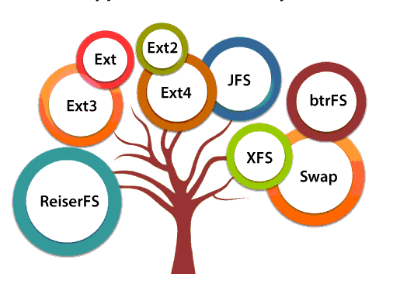
Types of Linux File System

Slide 23
Ext, Ext2, Ext3 and Ext4 file system
The file system Ext stands for Extended File System.
It was primarily developed for MINIX OS. The Ext file system is an older version, and is no longer used due to some limitations.

Slide 24
Ext2 is the first Linux file system that allows managing two terabytes of data. Ext3 is developed through Ext2; it is an upgraded version of Ext2.The major drawback of Ext3 is that it does not support servers because this file system does not support file recovery and disk snapshot

Slide 25
Ext4 file system is the faster file system among all the Ext file systems. It is a very compatible option for the SSD (solid-state drive) disks, and it is the default file system in Linux distribution

Slide 26
JFS File System
JFS stands for Journaled File System, and it is developed by IBM for AIX Unix. It is an alternative to the Ext file system.
It can also be used in place of Ext4, where stability is needed with few resources.
It is a handy file system when CPU power is limited.

Slide 27
ReiserFS File System
ReiserFS is an alternative to the Ext3 file system. It has improved performance and advanced features. In the earlier time, the ReiserFS was used as the default file system Linux, but later it has changed some policies,

Slide 28
XFS File System
XFS file system was considered as high-speed JFS, which is developed for parallel I/O processing.
NASA still using this file system with its high storage server (300+ Terabyte server).

Slide 29
Btrfs File System
Btrfs stands for the B tree file system. It is used for fault tolerance, repair system, fun administration, extensive storage configuration, and more.

Slide 30
Swap File System
The swap file system is used for memory paging in Linux operating system during the system hibernation. A system that never goes in hibernate state is required to have swap space equal to its RAM size.

Slide 31
SAR

Slide 32
SAR stands for System Activity Report, as its name suggest sar command is used to collect,report & save CPU, Memory, I/O usage in Unix like operating system.
By default SAR command displays result on the output screen, in addition result can also be stored in the file specified by the -o filename option.

Slide 33
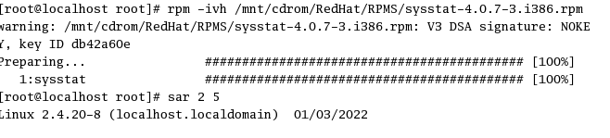
Mount cd3
Install sysstat package

Slide 34
Generating CPU Report 5 times every 2 seconds.
sar 2 5
Generating Memory Usage report using –r
sar -r 2 5

Slide 35
Generating Paging Statistics Report using –B
sar -B 2 5
Generating i/o Report using –b
sar -b 1 3

Slide 36
To report details about I/O operations like transaction per second, read per second, write per second
sar –b 2 5
To report run queue length, number of processes and load average
sar –q 2 5

Slide 37
To report details about the process, kernel thread, i-node, and the file tables
sar –v 1 5
Storing reports to log file
sar 2 5 -0 /var/log/sa/mca

Slide 38
reading reports from log file
sar 2 5 –r -f /var/log/sa/mca

Slide 39
The cron is a software utility, offered by a Linux-like operating system that automates the scheduled task at a predetermined time.
It is a daemon process, which runs as a background process and performs the specified operations at the predefined time when a certain event or condition is triggered without the intervention of a user

Slide 40
The crontab (abbreviation for “cron table”) is list of commands to execute the scheduled tasks at specific time.
It allows the user to add, remove or modify the scheduled tasks.
Use the crontab -e command from terminal

Slide 41
The crontab command syntax has six fields separated by space where the first five represent the time to run the task and the last one is for the command.
Linux Crontab Format
MIN HOUR DOM MON DOW CMD

Slide 42
Minute (holds a value between 0-59)
Hour (holds value between 0-23)
Day of Month (holds value between 1-31)
Month of the year (holds a value between 1-12 or Jan-Dec, the first three letters of the month’s name shall be used)

Slide 43
Day of the week (holds a value between 0-6 or Sun-Sat, here also first three letters of the day shall be used)
Command

Slide 44
